Slide 1
SQL Injection and Prevention
By Aindriya Barua

Slide 2
What is SQL Injection?
SQL stands for Structured Query Language
SQL lets you access and manipulate databases
SQL injection is the placement of malicious code in SQL statements, via web page input.
An attacker can use specially-crafted SQL commands to trick the application into asking the database to exchange unexpected commands.

Slide 3

Why should I care about it?
One of the top 10 web application vulnerabilities of 2007 and 2010 by the Open Web Application Security Project. In 2013, SQLI was rated the number one attack on the OWASP top ten.
According to Veracode research, 32% i.e, approximately one-third of applications have at least one SQL injection vulnerability
One of the main culprits in data breaches, including some of the most high-profile attacks.

Slide 4
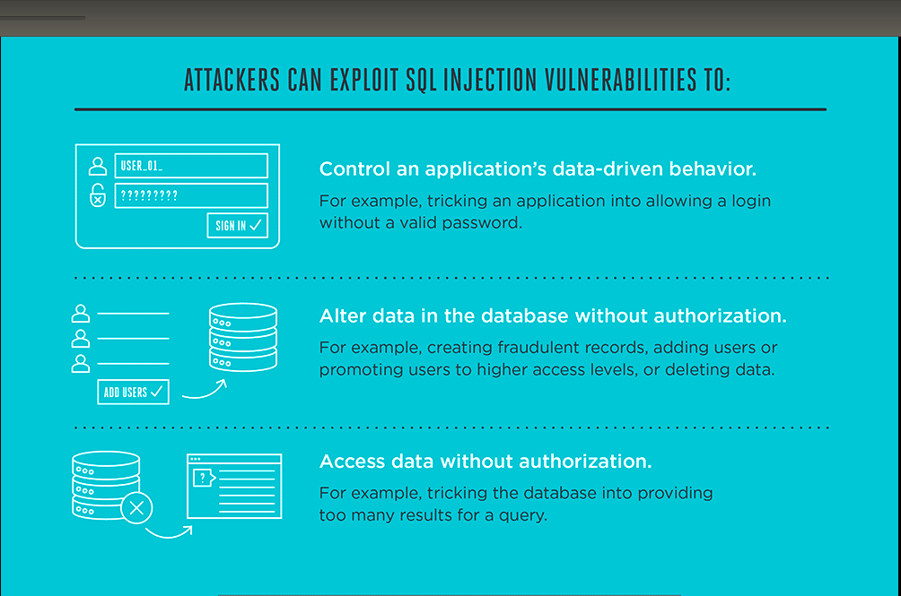

Slide 5

SOME FAMOUS SQL INJECTION ATTACKS

Slide 6
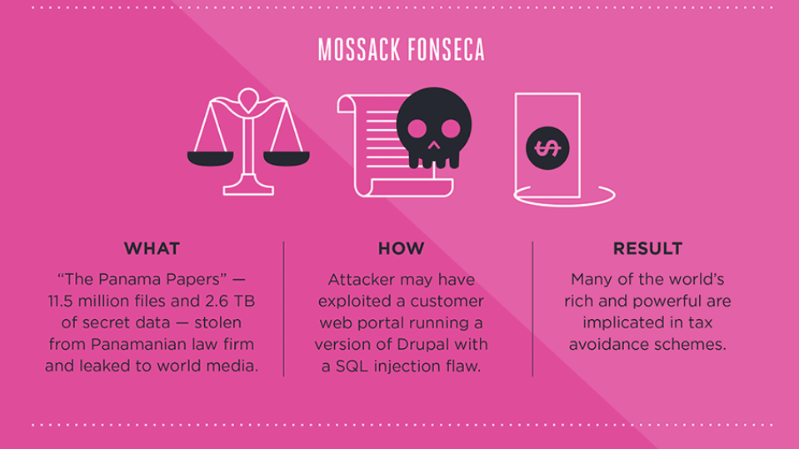

Slide 7
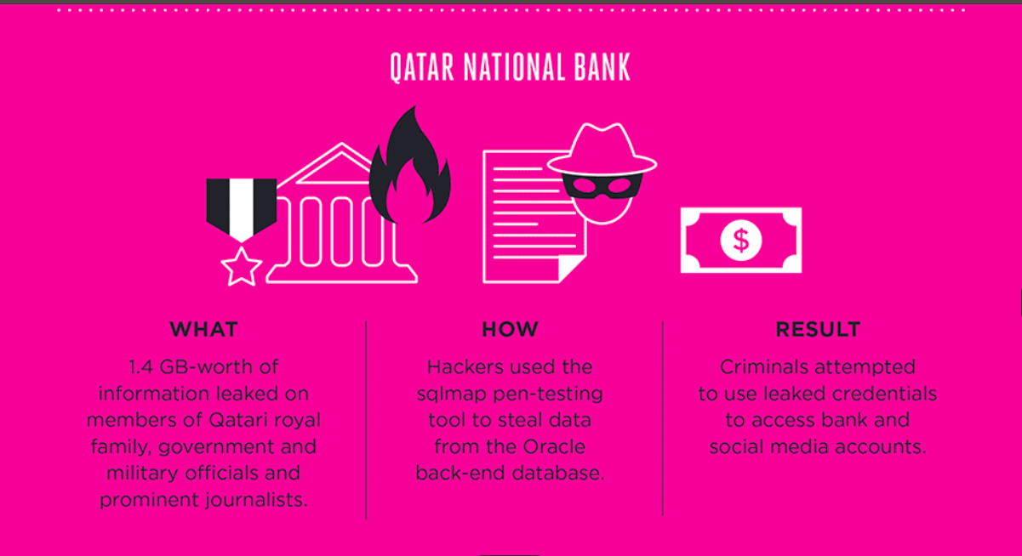

Slide 8
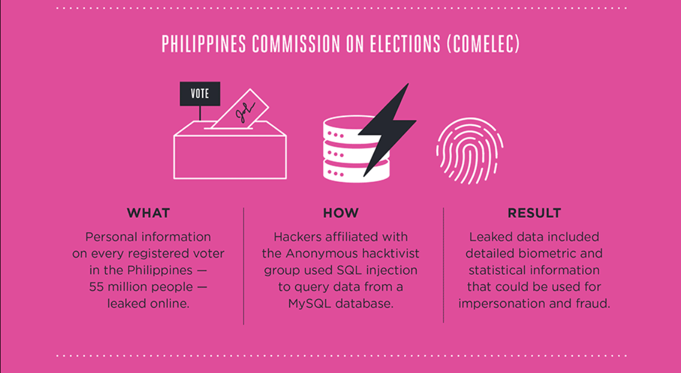

Slide 9
Anatomy of SQLi
Examination:
Attacker tries submitting various unexpected values for the argument and see how the application responds.
Attack:
Attacker provides a carefully crafted input value that will be interpreted as part of a SQL command rather than merely data; the database then executes the SQL command as modified by the attacker.

Slide 10
Let’s see how it works...
SQL injection usually occurs when you ask a user for input, like their username/userid, and instead of a name/id, the user give you an SQL statement that you will unknowingly run on your database.
Normal database query and how it works:
txtUserId = getRequestString("UserId");
txtSQL = "SELECT * FROM Users WHERE UserId = " + txtUserId;
Then, the SQL statement will look like this:
SELECT * FROM Users WHERE UserId = 16503;
Then, the SQL statement will look like this:
SELECT * FROM Users WHERE UserId = 14156503 OR 1=1;

Slide 11
SQL Injection Based on 1=1 is Always True
Now, what if we give the following input?
Then, the SQL statement will look like this:
SELECT * FROM Users WHERE UserId = 14156503 OR 1=1;
The SQL above is valid and will return ALL rows from the "Users" table, since OR 1=1 is always TRUE.

Slide 12


SQL Injection Based on ""="" is Always True
Here is an example of a user login on a web site:
uName = getRequestString("username");
uPass = getRequestString("userpassword");
sql = 'SELECT * FROM Users WHERE Name ="' + uName + '" AND Pass ="' + uPass + '"'
Result:
SELECT * FROM Users WHERE Name ="Nikitha” AND Pass ="nambiar123"

Slide 13
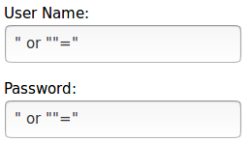
Contd.
What if we give following inputs?
RESULT:
SELECT * FROM Users WHERE Name ="" or ""="" AND Pass ="" or ""=""
The SQL above is valid and will return all rows from the "Users" table, since OR ""="" is always TRUE.

Slide 14

SQL Injection Based on Batched SQL Statements
Most databases support batched SQL statement.
A batch of SQL statements is a group of two or more SQL statements, separated by semicolons.
The SQL statement below will return all rows from the "Users" table, then delete the "Marks’" table.
SELECT * FROM Users; DROP TABLE Marks
txtUserId = getRequestString("UserId");
txtSQL = "SELECT * FROM Users WHERE UserId = " + txtUserId;
And the following input:
The valid SQL statement would look like this:
Result
SELECT * FROM Users WHERE UserId = 105; DROP TABLE Marks;

Slide 15
SQLi Prevention

Slide 16
How to mitigate the risk?
Escape all user supplied input
Always validate input
Use prepared statements
Use parameterized queries (using bindParam())
Code reviews
Don’t store password in plain text in the DB. Salt them and hash them

Slide 17
Validate all input
Validating a Free Form Text Field for allowed chars (numbers, letters, whitespace, .-_)
^[a-zA-Z0-9\s._-]+$ (Any number of characters)
^[a-zA-Z0-9\s._-]{1-100}$ (This is better, since it limits this field to 1 to 100 characters)

Slide 18
URL Rules
No parentheses or angular brackets in the URLs
While saving or generating remove from the URLs
If you really need to have parentheses or angular brackets in the URL, then encode them
URL should not end with two or more dashes “--“
While saving or generating remove these from the URLs
URL should not end with “/*”
No schema, table or column names should be part of your URL

Slide 19
Sources
https://en.wikipedia.org/wiki/SQL_injection
https://www.veracode.com/
https://www.w3schools.com/sql/sql_injection.asp
https://www.tutorialspoint.com/sql/sql-injection.htm
https://www.w3schools.com/php/php_mysql_intro.asp
http://stackoverflow.com/questions/60174/how-can-i-prevent-sql-injection-in-php
https://www.owasp.org/index.php/SQL_Injection

Slide 20
Thank you for your Attention! :)
Any Questions?

